Slide 1
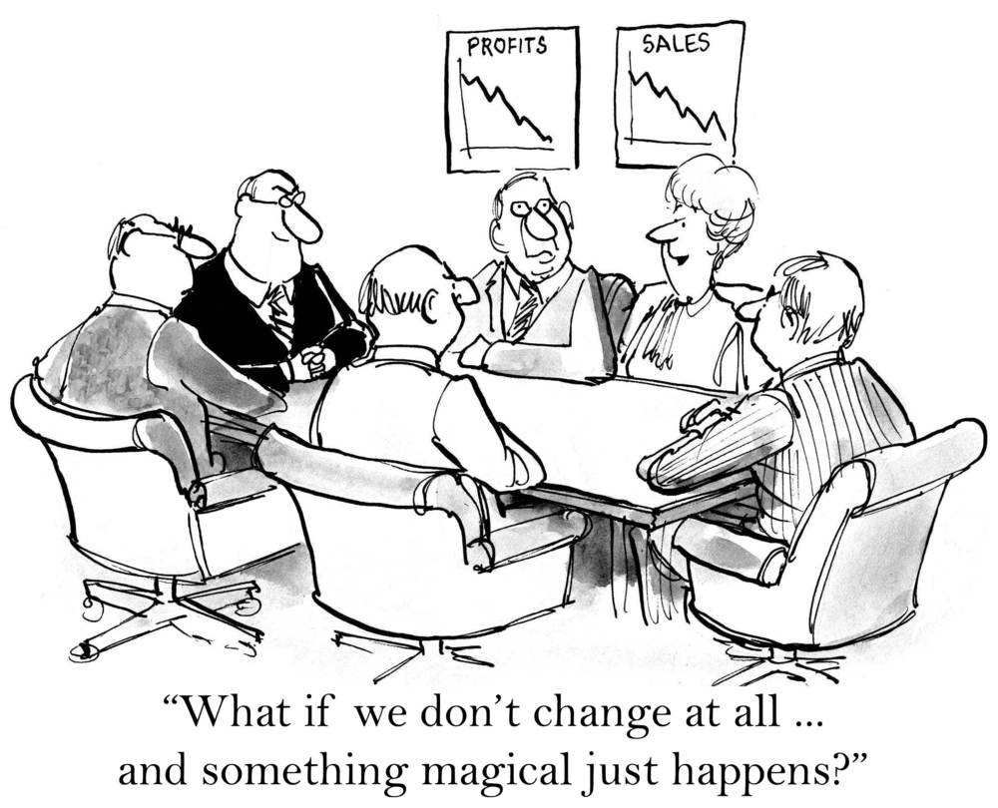
Integrating OpenStack into a Legacy Enterprise Environment
OpenStack Summit – Austin, TX
Rick Ashford
Sr. Systems Engineer
rick.ashford@suse.com
Sean Rickerd
Sr. Systems Engineer
srickerd@suse.com

Slide 2
Hello and Welcome!
Sean Rickerd
Nationality: Canadian
Interests: SUSE, Linux, OpenStack, Music (the heavier kind), Technology
Accomplishments: Toured the Continental US in a Death Metal Band,
Shodan in Shaolin Kempo, Winner of the Most Beautiful Locks of Award,
and official ambassador of “La gang de fous icitte à Montréal”
Rick Ashford
Nationality: Texan
Interests: SUSE, Linux, OpenStack, Superheroes, Food, Building Stuff
Accomplishments: SUSE OpenStack Cloud GURU, BBQ Pit Master, receiver of the Royal Canadian “You’re a Nice Guy” Award (presented by Sean Rickerd), and has successfully completed numerous woodworking projects (successful = 10 fingers in, 10 fingers out)
Notes:
Hello, blah blah, fill in some time.
I’m Sean, this is Rick (mention Canadian vs Texan)
Is anyone here Canadian? - move to next slide (if audio available, Canadian National Anthem plays).

Slide 3
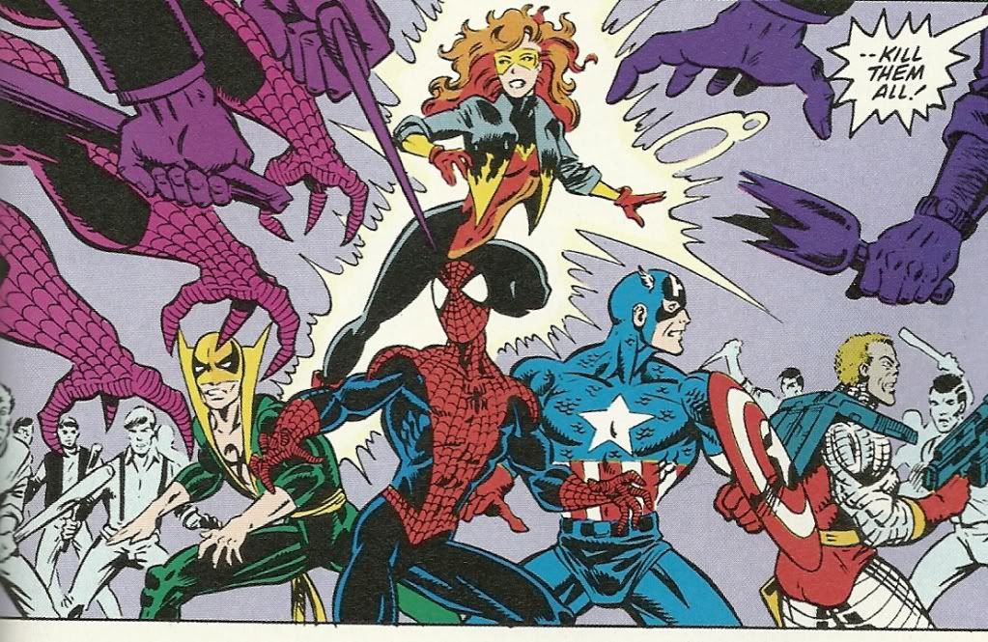
Typical IT/End User Relationship

Slide 4

Ideally it's all the same...

Slide 5
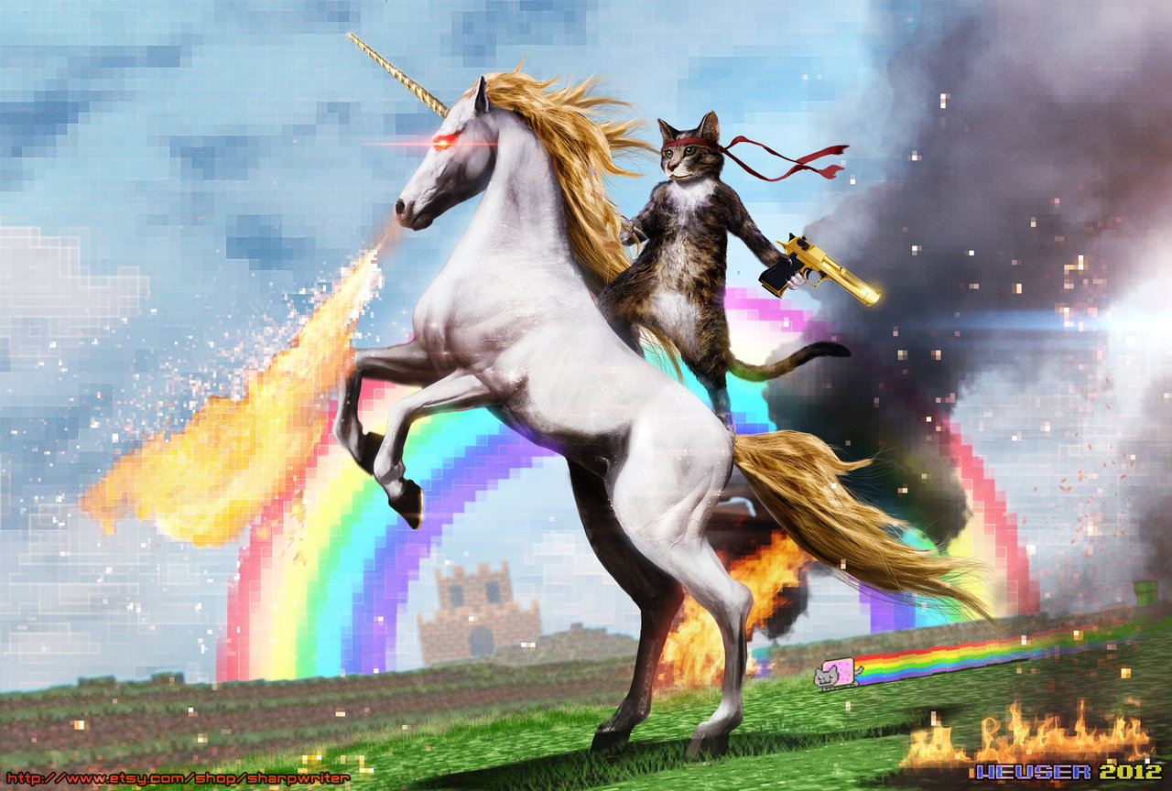

Slide 6
OpenStack:Not the only kid in the sandbox
You have:
Hardware and software management forced you to purchase and you now have to justify their decision so they get their bonus.
Standardized virtualization platform. And the one the Windows group insisted on. And the one the developers started using without telling you. And the one that single critical app has to sit on to be certified. And…
“We bought one of everything”
Notes:
Most of the time, when people are talking about implementing OpenStack, they’re not talking about a “net new” install. They’re looking to leverage the infrastructure they already have in place to build their Private Cloud On.
This means that most new installs have existing hardware. That means they have existing hypervisors and virtualization. That means they have existing networks and security configurations. They have existing EVERYTHING.

Slide 7

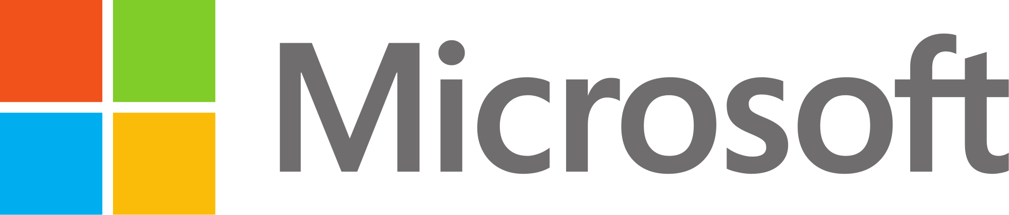
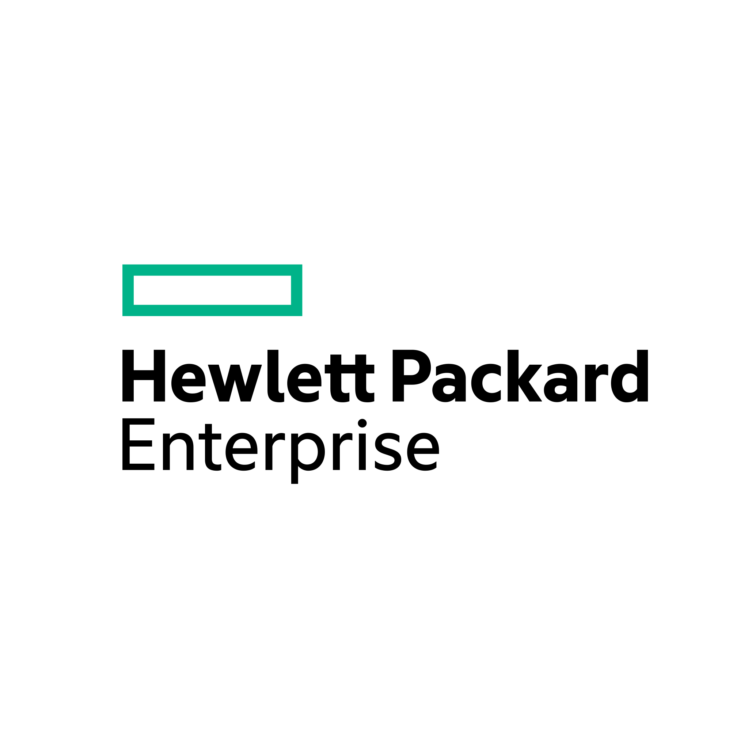
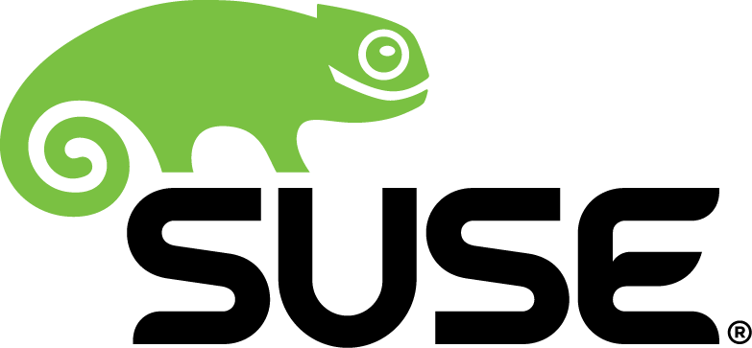

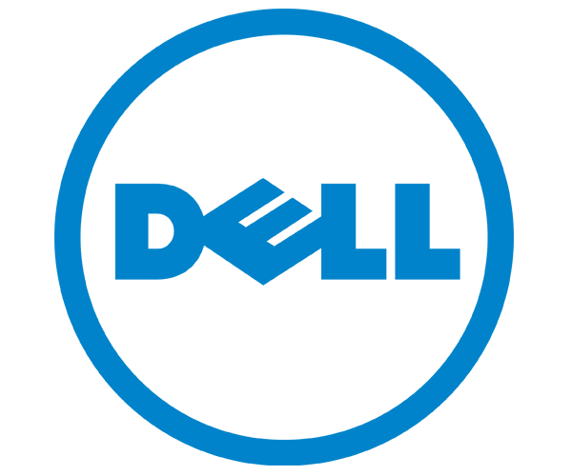
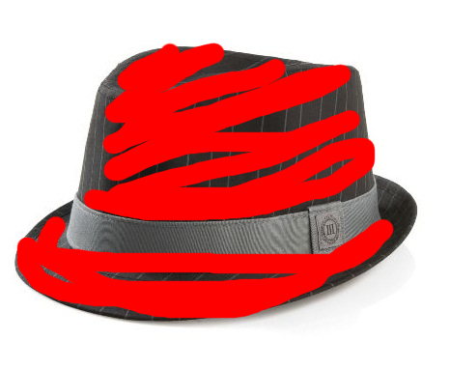
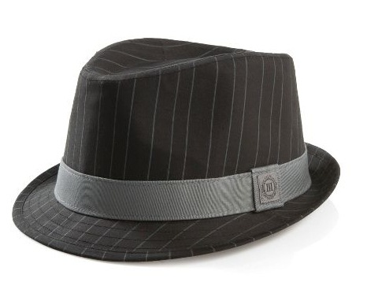
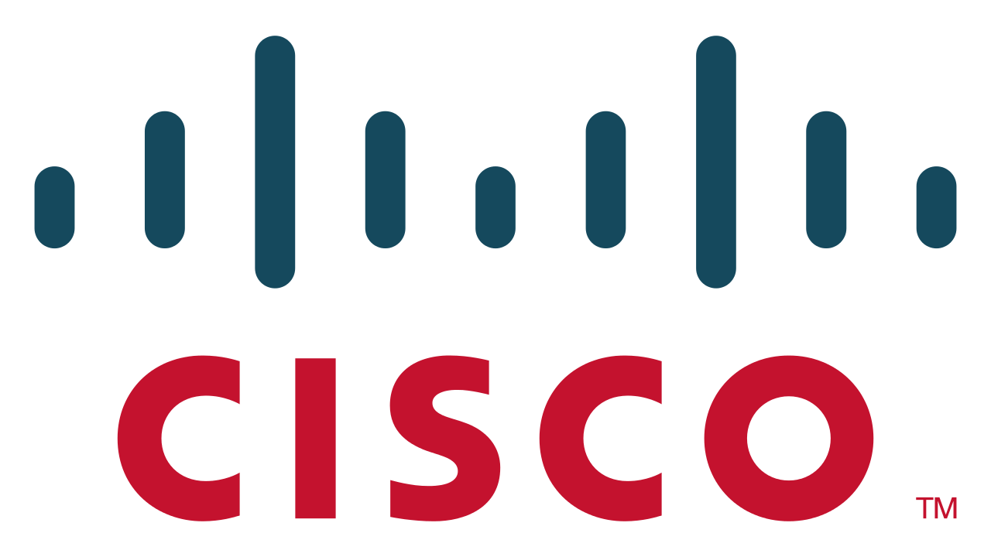
You have existing infrastructure
Notes:
Those infrastructures will have various different technologies already working in the environment.
They might have the adorably stable and efficient Chameleon – SUSE. They might have a large Microsoft footprint. They might have Cisco UCS, or HP, or IBM hardware. <click> They might even have hats! Oh, wait, that’s not quite right. <click> There we go.

Slide 8


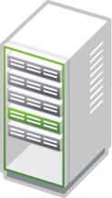

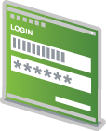

Securing OpenStack http://docs.openstack.org/security-guide/
Adjust existing security infrastructure
Encrypt all traffic?
Self-signed vs External
SE Linux/App Armor
Single sign-on
Patching strategy

Slide 9
Existing Authentication Framework
TL;DR Version
Leverage hybrid authentication driver (introduced in Juno)
    Authentication = LDAP (OpenLDAP/Active Directory)
    Metadata = Keystone/OpenStack
    http://docs.openstack.org/security-guide/identity/federated-keystone.html
    https://www.suse.com/documentation/suse-openstack-cloud-6/singlehtml/book_cloud_deploy/book_cloud_deploy.html#sec.depl.ostack.keystone.ldap.hybrid
Notes:
If you did miss Martin’s presentation, I’m going to just mention a couple of key points regarding an AD implementation.
The one thing you must do, is change the configuration on orginazationalRole to allow groupOfNames as a possible superior.
In Active Directory the organizationalUnit object class contains the User object class—it is said to be a “possible superior”. This relationship is maintained through an attribute of the User object named possSuperiors, which is set to a value that contains organizationalUnit as well as any other object classes that are above the User class in the relational hierarchy.
In order to integrate Keystone with Active Directory the groupOfNames class must be configured as a possible superior of the organizationRole class.
Requirements for this are that the user modifying the configuration of the schema needs to be in the Schema Administrators group and the configuration must be done on the AD schema master.

Slide 10




Existing Storage
What do you want to keep?

Slide 11

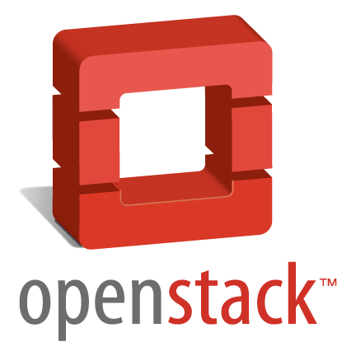
Existing Workloads
Clean Builds
vs
Leverage Existing

Slide 12


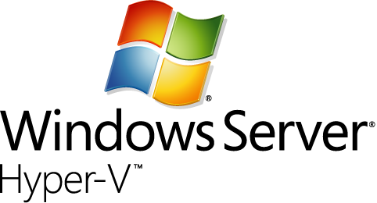
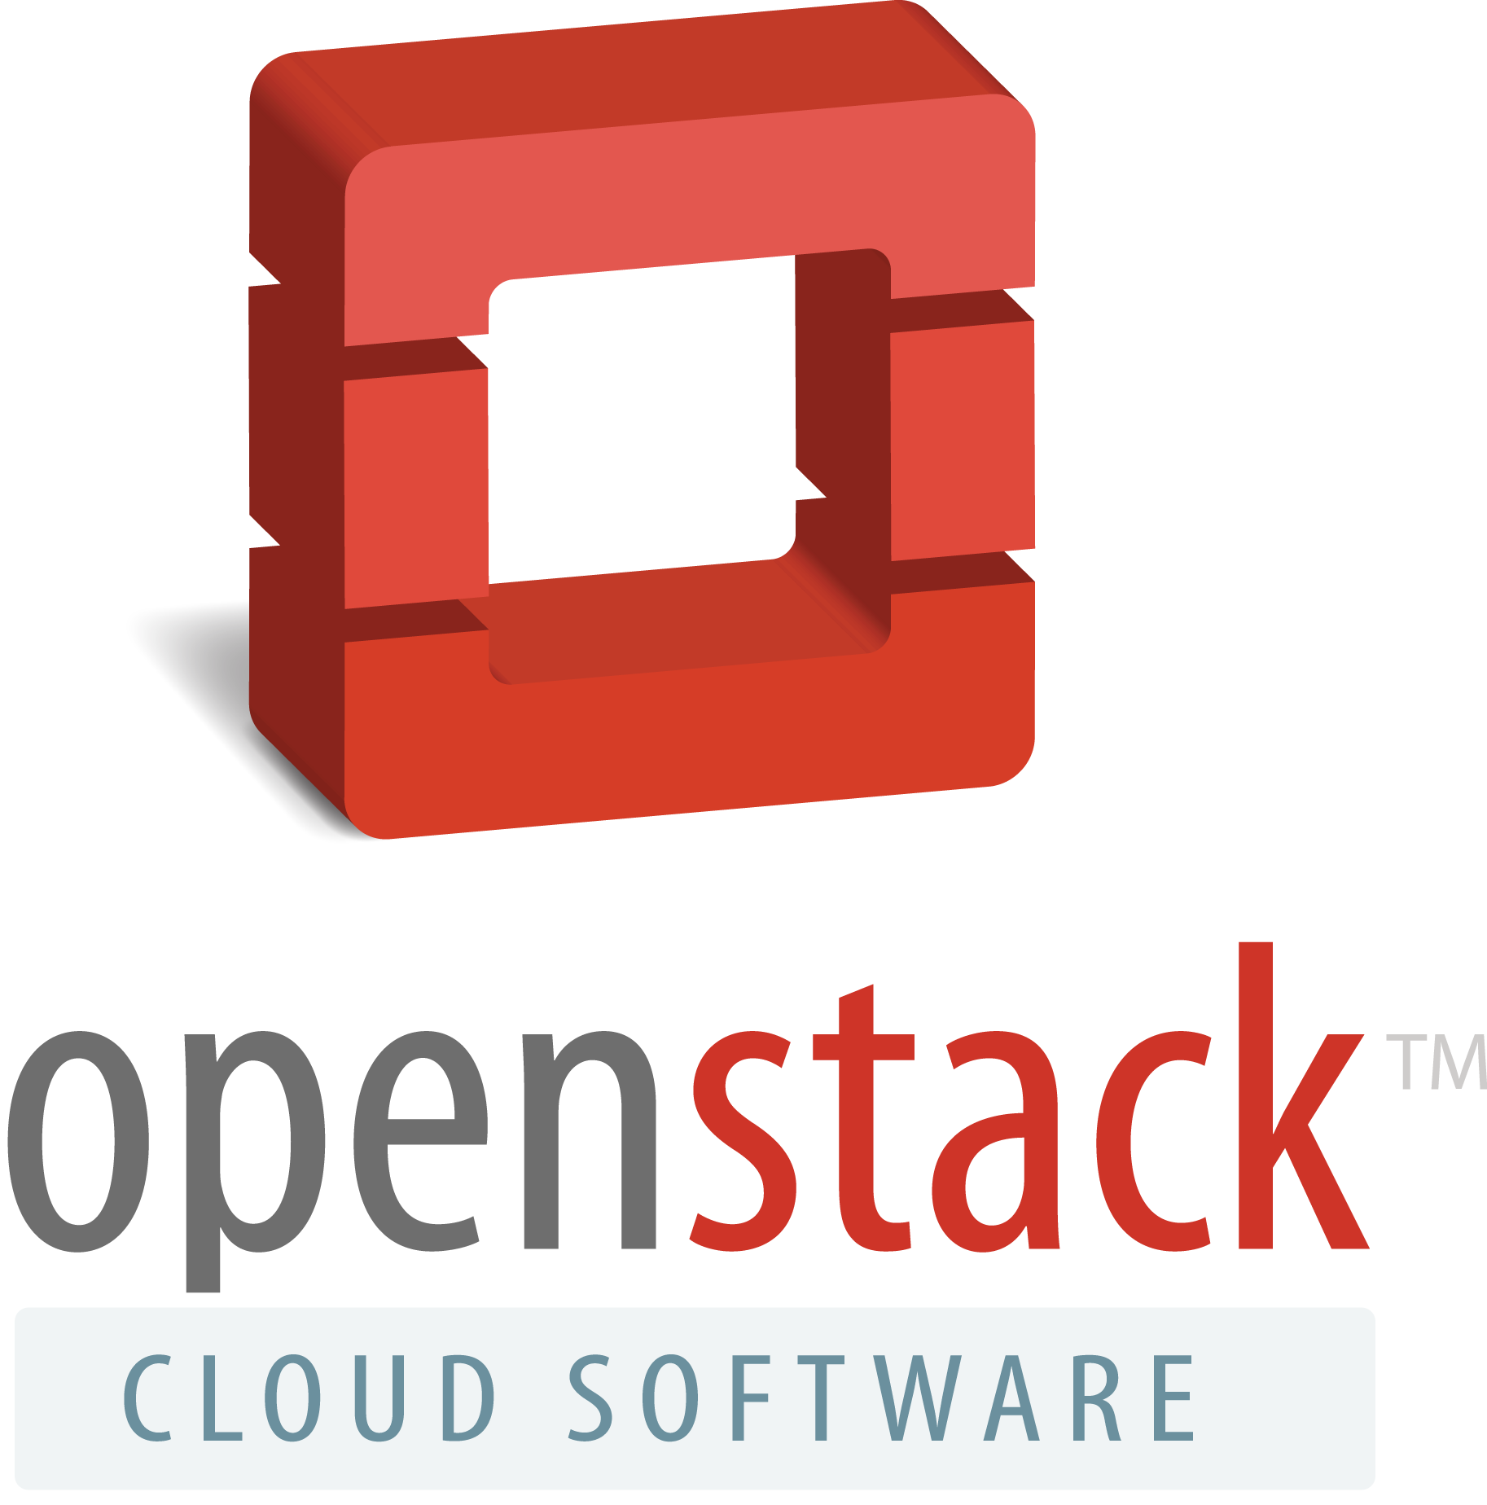
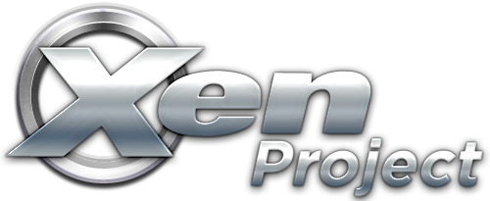

Multi-Hypervisor Environments
Multi-Hypervisor Environments

Slide 13
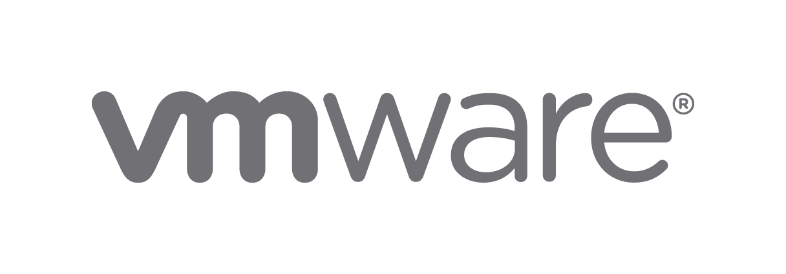

Limitations
No iptables = no security groups
No live migration (via OpenStack)
Supported SDN = NSX
No GRE encapsulation in Open vSwitch (Flat/VLAN/VLANX)

Slide 14
Limitations
No iptables = no security groups
2 NICs required (1 x Management, 1 x Guest)
Enable iSCSI initiator service
Configure Shared-Nothing Live Migration
No GRE encapsulation in Open vSwitch (Flat/VLAN/VLANX)
Disable NUMA spanning for performance
Requires Python 2.7 32-bit

Slide 15
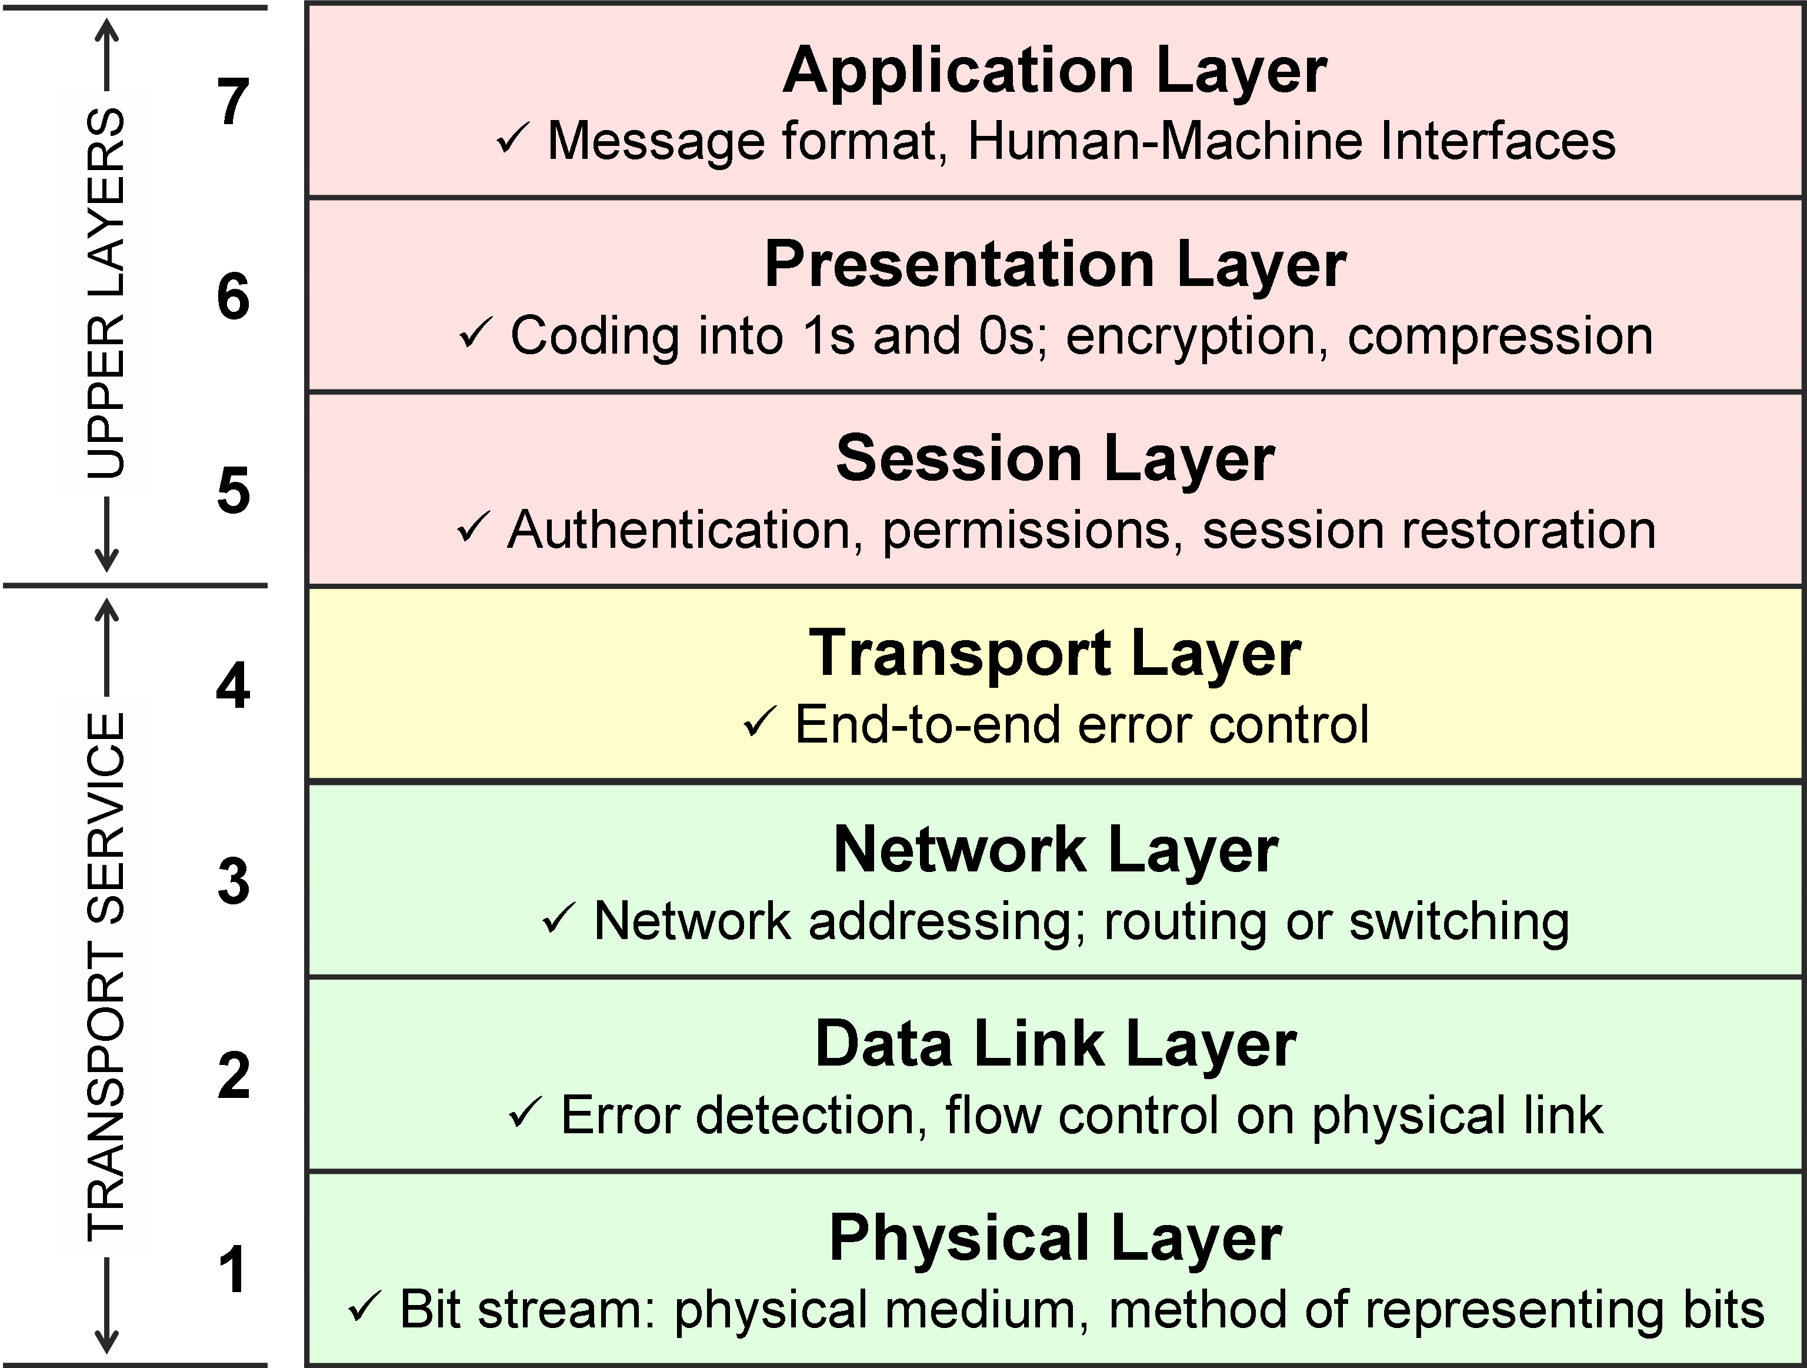
Networking
9 Money
8 Politics

Slide 16
Choosing an OpenStack vendor
“Linux is free as long as your time is worth nothing to you.”
– Rick's Dad
– also –
“OpenStack is not free as in beer or free as in speech. It's free as in puppy.”
– Rick

Slide 17
Choosing an OpenStack vendor
SUSE sponsored study on enterprise OpenStack adoption
86% of respondents said the lack of skills in the market is making their companies reluctant to pursue private cloud.
In addition,78% of companies that have yet to adopt private cloud are deterred by the skills shortage.
http://www.reuters.com/article/suse-cloud-study-idUSnPn28yxy2+80+PRN20160120

Slide 18
Choosing an OpenStack vendor
Many organizations have existing SLAs with stringent turn-around times
  Does your targeted vendor's support organization have the appropriate expertise for rapid turnaround of complex issues (OS and OpenStack)
Compliance with government regulatory standards require support contracts
Hardware & software certifications for existing apps & infrastructure

Slide 19


Slide 20
Notes:
Now I would like to introduce [SUSE Manager speaker] who will talk to you about some exciting updates for SUSE Manager.

